Slide 1
FERMENTATION
IN FOOD PROCESSING
By: WIN and Friends

Slide 2

Introduction
Ethanol Fermentation
Lactic Acid Fermentation
Acetic Acid Fermentation
Carbohydrate —> Alcohol, CO2 , organic acid
Yeast and Bacteria
Anaerobic condition

Slide 3
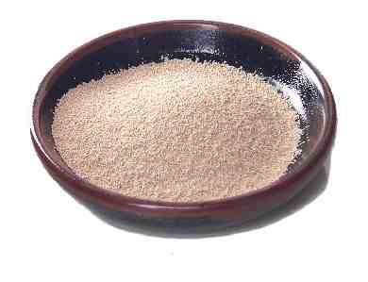
Ethanol Fermentation
Use Yeast for fermentation
Anaerobic process.
Occur in the absence of oxygen
Alcoholic beverages
Bread baking: CO2 helps bread puffy
Microbes
• Yeast
• Zymomonas mobilis
• Schizosaccharomyces

Slide 4

Ethanol Fermentation
C6H12O6 + Zymase → 2 C2H5OH + 2 CO2
glucose
ethanol

Slide 5

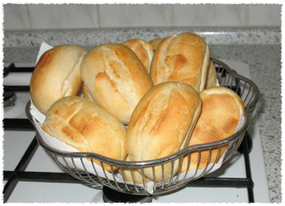

Ethanol Fermentation
Beer
Wine
Bread

Slide 6
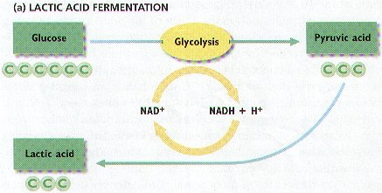
Lactic Acid Fermentation
Convert C6H12O6 → 2CH3CH(OH)COOH
glucose
Lactic Acid

Slide 7
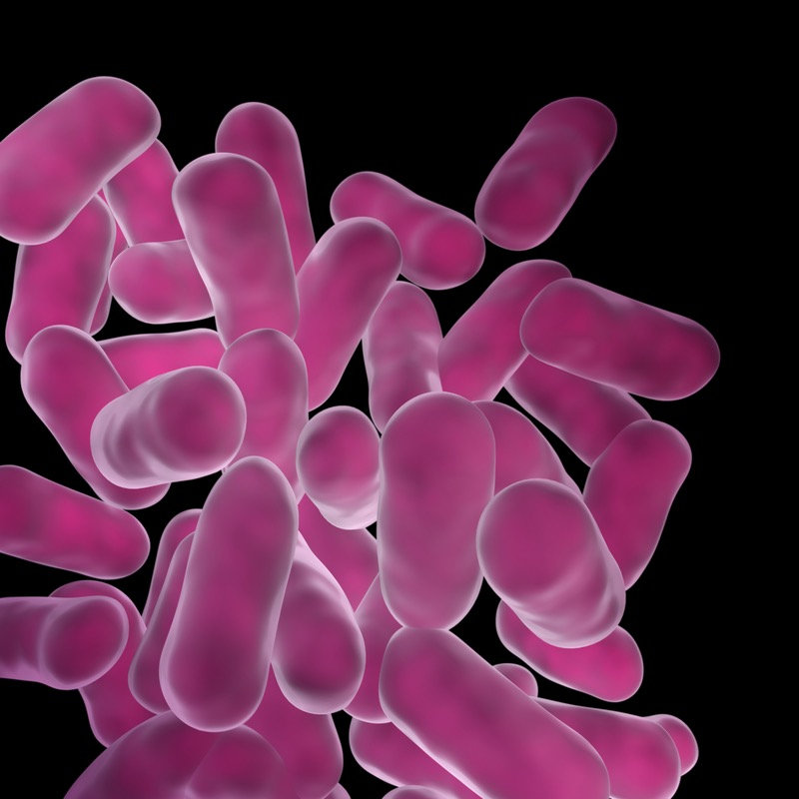
Lactic Acid Fermentation
Use Bacteria for fermentation
Lactobacillus *** most important ***
leuconostoc mesenteroides
pediococcus cerevisiae
treptococcus lactis
bifidobacterium bifidus

Slide 8
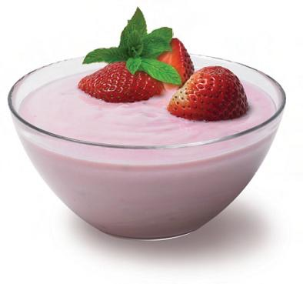
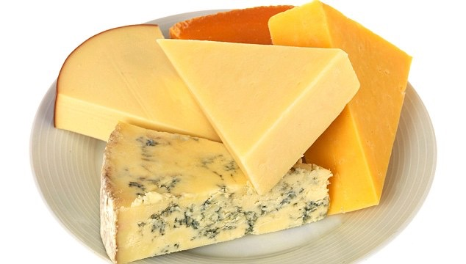
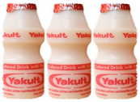
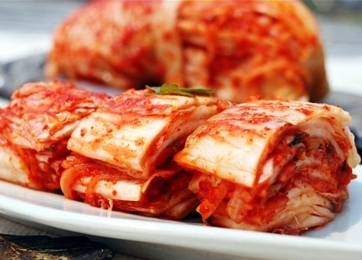

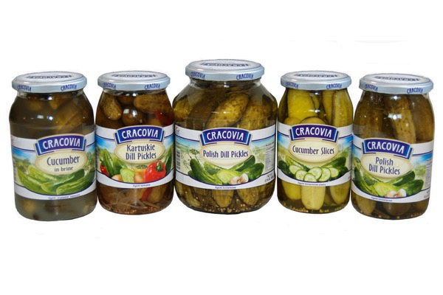
Lactic Acid Fermentation
Daily Products:
Cheese, yoghurt and fermented milk drinks
produce acid from the milk sugar lactose
Fermented vegetables:
Sauerkraut, KimChi

Slide 9
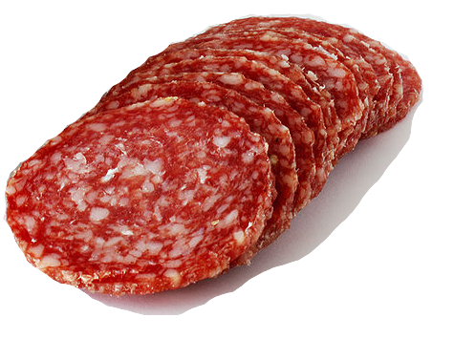
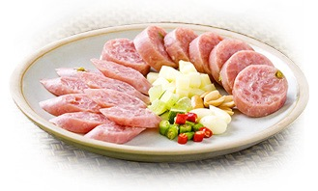
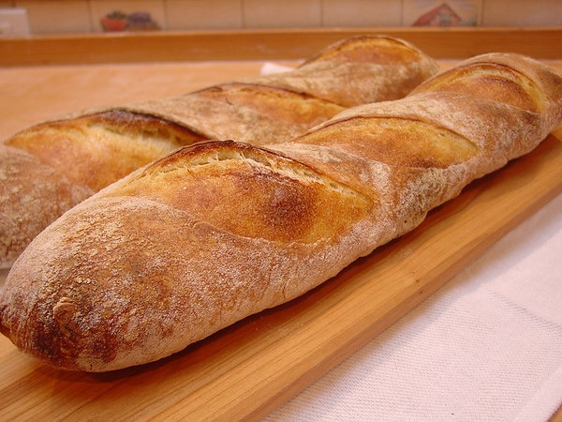
Lactic Acid Fermentation
Fermented meats:
Nham, Salami
Fermented doughs:
works with yeast
improve structure, flavour and storage
French bread

Slide 10
Acetic Acid
organic compound in vinegar
produced industrially both synthetically and bacterial fermentation

Slide 11
Acetic Acid Fermentation
C2H5OH + O2 → CH3COOH + H2O
alcohol + oxygen —(acetobacter)—> acetic acid + water
Acetobacter = name of bacteria
Commonly used feeds include
apple cider, wine

Slide 12
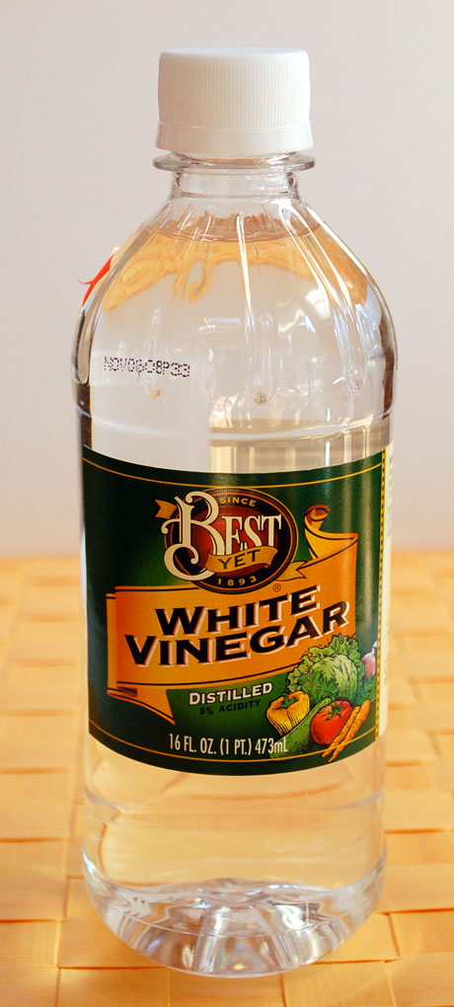
Acetic Acid Fermentation (Distillation)
Fermentation of distilled alcohol
A diluted alcohol solution ferment with Acetobacter
Kept in a warm, airy place
The alcohol is diluted to produce a colourless
solution of acetic acid in water.
Accelerate this process by improving
the supply of oxygen to the bacteria.

Slide 13

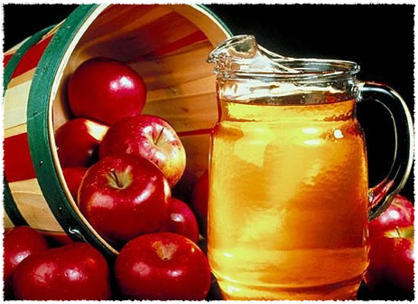
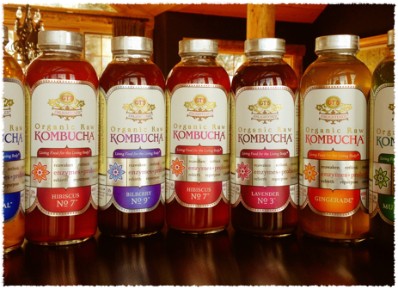

Slide 14
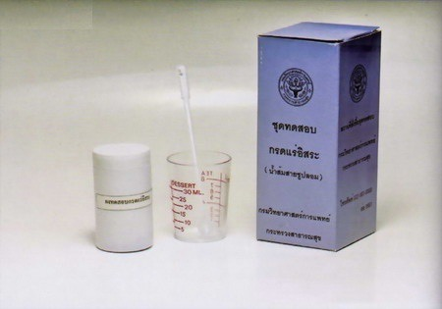
Fake Vinegar

Slide 15
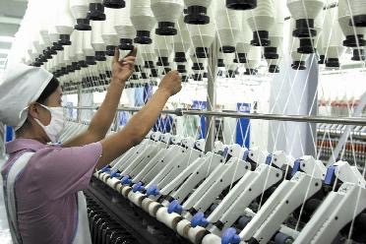
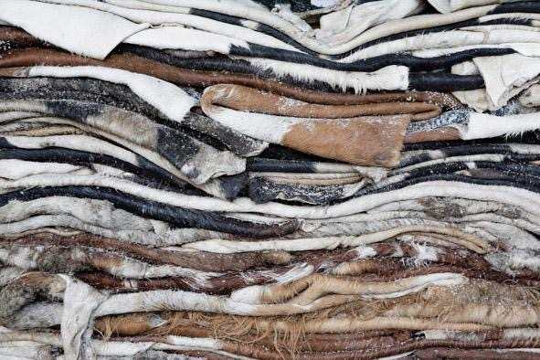
Fake Vinegar
Used in Industry

Slide 16

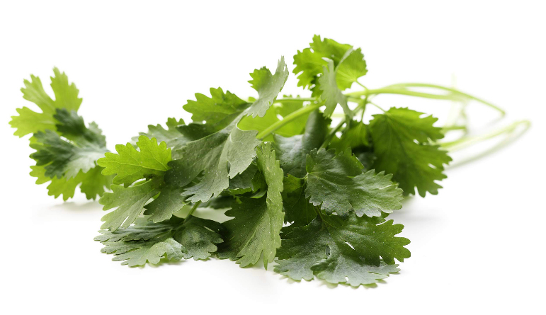
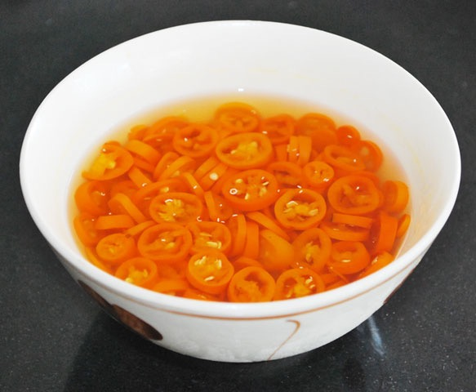
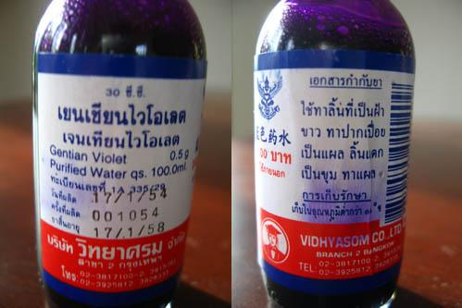
Fake Vinegar
1. Flat thin leaves test
3. Smell test
2. Chili test
4. Gentian violet test

Slide 17

Fake Vinegar
For Safety

Slide 18
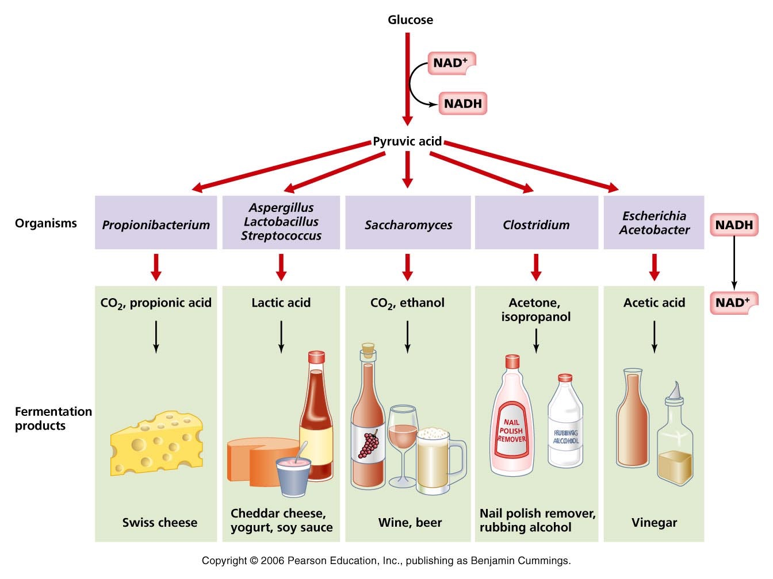
Conclusion

Slide 19
Question?

